Slide 1


SOLNOVA ENERGY PVT LTD
Team Members
AMAN SINGH – MBA25056
KSHITIJ BARANWAL – MBA25243
ANISH DEY – MBA25058
PRATEEK SAGAR – MBA25078
ROHIT GHOSH – MBA25084
ADHIRAJ SINGH – MBA25053

Slide 2
RATIONALE AND CLASSIFICATION
Direct Alignment with SDG 13: Climate Action: Solar energy is a direct substitute for fossil fuels, crucial for reducing greenhouse gas emissions.
Addressing India's Urgency: India is highly vulnerable to climate hazards like droughts and floods, making a clean energy transition essential.
Strong Business Potential: The growing demand for solar solutions offers both profitability and significant environmental impact.
Sector: Energy
Sub-sector: Renewable Energy
Category: Solar-Powered Energy
NIC Code: 35105 (Electricity generation from solar photovoltaic (PV) and solar thermal sources)

Slide 3
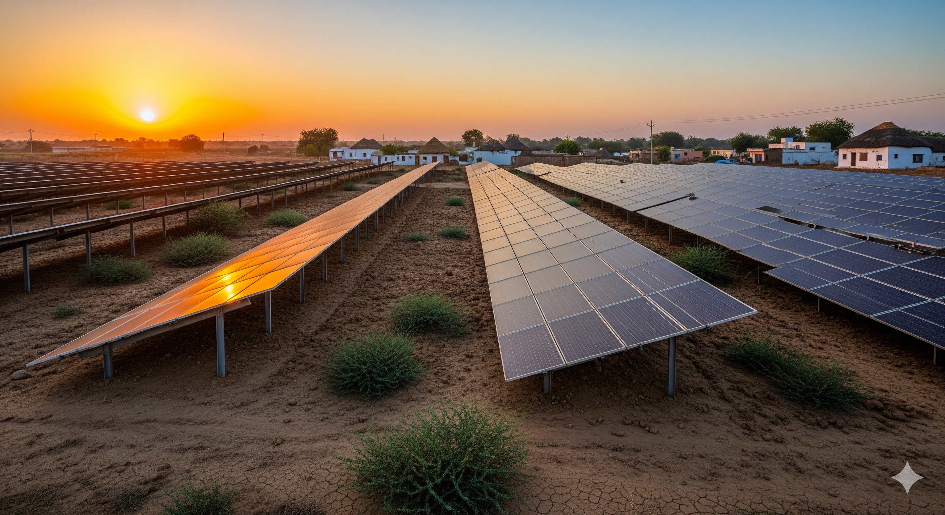
SIZE AND SCOPE
Installed Capacity (India 2024): ~72 GW
Target by 2030: 280 GW
Applications: Grid plants, rooftop systems, solar pumps, rural microgrids
Employment Potential: 1M+ green jobs projected
Global Solar Market: $253.7B (2023) → $436.4B (2032), CAGR ~6%

Slide 4
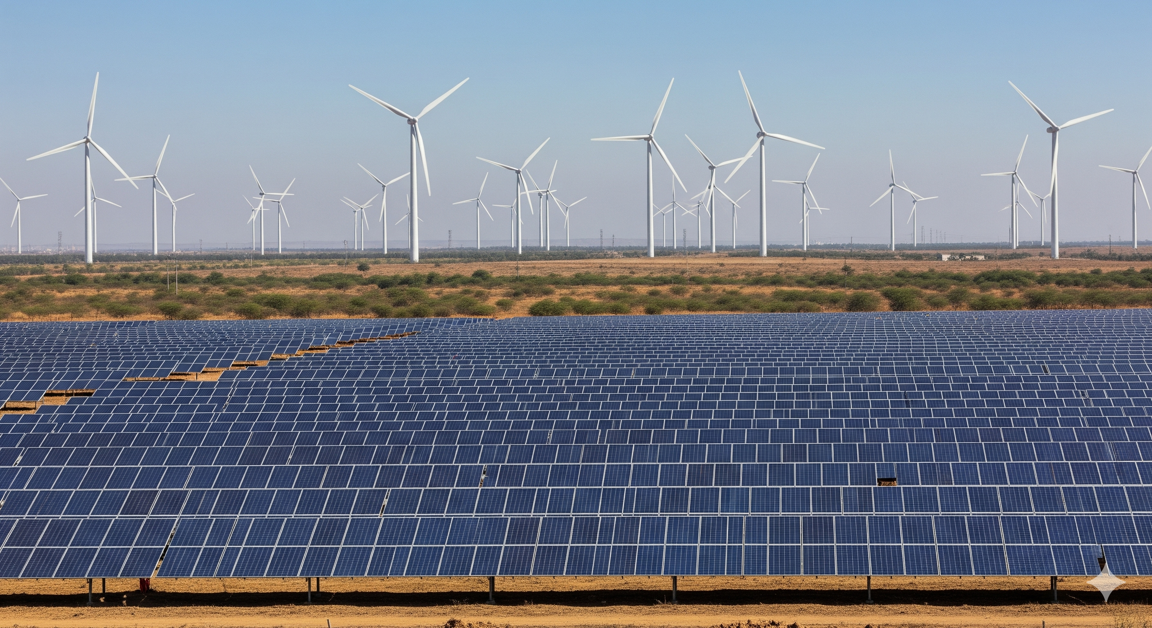
GROWTH, GDP AND LIFE CYCLE
Renewables = ~30% of India’s installed capacity (2023)
Solar = ~54% of India’s renewable capacity (~67 GW)
Global solar = ~80% of new renewable capacity (2024)
Contribution: Solar + Wind = ~7% of global electricity (2024)
Industry Life Cycle Stage: Growing → Shaking Out phase

Slide 5
COMPETITIVE LANDSCAPE AND PESTEL
Global Players: Jinko Solar, JA Solar, Trina Solar (China dominates ~80% supply chain)
Indian Player: Vikram Solar (4.5 GW/year capacity)
PESTEL:
Political: 500 GW renewable target by 2030, subsidies
Economic: Solar PV costs ↓ 80% since 2010
Social: 250K jobs (2023) → 1M by 2025
Technological: 20–22% panel efficiency, battery costs ↓ 89%
Environmental: 37M tons CO₂ avoided (2021)
Legal: Supportive policies, occasional tariff/payment delays

Slide 6

UN SDGS OVERVIEW
Adopted in 2015 by UN
17 universal goals: poverty, planet protection, prosperity
Integrated approach (social, economic, environmental)

Slide 7
CHOSEN GOAL – SDG 13 (CLIMATE ACTION)
Mission: “Take urgent action to combat climate change and its impacts”
Rationale:
Directly reduces GHG emissions
India vulnerable to climate change effects
Aligns with Paris Agreement commitments
Growing business and impact opportunity

Slide 8

SDG 13 – TARGETS
13.1: Strengthen resilience to climate hazards
13.2: Integrate climate change in policies & planning
13.3: Education and awareness on climate change
13.a: Climate finance commitments
13.b: Build capacity in developing countries

Slide 9
CONTRIBUTION PLAN
Target 13.2:
Affordable rooftop kits for rural households
Solar in public buildings (state agency partnerships)
Advocate for solar policy incentives
Target 13.3:
Launch “Solar for Climate” awareness campaign
Train youth as certified solar technicians
Build carbon-tracking mobile app

Slide 10
COMPANY OVERVIEW
Name: SolNova Energy Pvt. Ltd.
Founded: 2022 | HQ: Pune, India
Business Scope:
Solar manufacturing & installation
Microgrid solutions for rural areas
Carbon footprint consultancy
Goal: Make solar power affordable, accessible, reliable

Slide 11
LOGO ANALYSIS
Design: Golden sun over teal horizon, infinity symbol rays
Meaning: Endless renewable energy, optimism, sustainability
Color Palette:
Sunburst Yellow → energy, warmth
Ocean Teal → water, calm, sustainability
Deep Charcoal → grounded, professional
Black → sharp, modern contrast

Slide 12
MISSION, VISION, VALUES
Mission: Empower communities with clean, affordable solar energy
Vision: Make solar India’s primary energy source; carbon-neutral by 2040
Core Values:
Sustainability
Innovation
Accessibility
Integrity
Collaboration

Slide 13
STAKEHOLDERS
Internal:
Founders
Board
Engineers, Technicians, Sales/Admin, R&D, Operations
Finance
Legal
External:
Customers
Suppliers,
Government
NGOs
Investors
Local communities, Educational institutions

Slide 14
Internal Communication Strategy: Engaging Our Team
Targeted Stakeholders:
Founders & Board of Directors
Employees (engineers, technicians, sales, admin)
R&D Department
Operations Team
Rationale for Targeting:
Engaging our internal teams is crucial because they are the driving force behind SolNova's mission. Their understanding and commitment to SDG 13 are essential for integrating climate action into daily operations, from manufacturing to installation and consultancy.

Slide 15
Strategy & Rationale: Building a Climate-Conscious Culture
Strategy:
Monthly "SDG 13 Spotlight" Newsletter: An internal newsletter to highlight company achievements, new policies, and individual employee contributions related to SDG 13.
"Green Innovator" Recognition Program: A program to recognize employees who propose and implement innovative, sustainable solutions.
Mandatory SDG 13 Training: Integrate climate action and sustainability training into the onboarding process for all new employees.
Rationale for Strategy:
Rationale for Monthly Newsletter: This channel ensures consistent information reaches all employees.
Rationale for "Green Innovator" Recognition Program: It incentivizes innovation and a proactive approach to sustainability, aligning with a core company value.
Rationale for Mandatory Training: This ensures every employee understands their role in contributing to SDG 13.

Slide 16

Prototype: "Green Innovator" Recognition Program

Slide 17
Internal Communication Channels
Channels:
Email & Internal Newsletter: For company-wide updates, policy changes, and the "SDG 13 Spotlight".
Internal Social Platform (e.g., Slack/Teams): For quick communication, team-based collaboration, and sharing short-form success stories.
Monthly Town Hall Meetings: To provide updates from founders and the board and to celebrate the "Green Innovator" of the month in person.
Rationale:
Rationale for Email & Internal Newsletter: For company-wide updates, policy changes, and the "SDG 13 Spotlight" newsletter.
Rationale for Internal Social Platform (e.g., Slack/Teams): For quick communication, team-based collaboration, and sharing short-form success stories.
Rationale for Monthly Town Hall Meetings: To deliver mandatory training on climate action and its connection to the company's work.
.

Slide 18
External Communication Strategy: Building Trust & Impact
Targeted Stakeholders:
Customers (households, businesses, rural communities)
Government & Regulatory Bodies
Investors
NGOs & Environmental Organizations
Rationale for Targeting:
These stakeholders are crucial for scaling SolNova's operations and achieving its vision. Engaging them directly builds brand loyalty, secures financial support, and helps influence policy for accelerated solar adoption.

Slide 19
Strategy & Rationale: Amplifying Our Impact
Strategy:
"My Solar Impact" Mobile App: An application allowing customers to track their carbon footprint reduction, energy savings, and direct contribution to SDG 13.
Policy Advocacy White Papers: Publish research and white papers for government agencies to advocate for supportive solar policies.
Partnership with NGOs: Collaborate on community awareness campaigns and training programs to certify local youth as solar technicians.
Rationale for Strategy:
Rationale for "My Solar Impact" Mobile App: The app helps us make solar power accessible and reliable, contributing directly to SDG 13.
Rationale for Policy Advocacy White Papers: This formal approach positions SolNova as a thought leader and helps us advocate for policy incentives.
Rationale for Partnership with NGOs: This amplifies our reach and contributes to SDG 13 by promoting education and awareness.

Slide 20
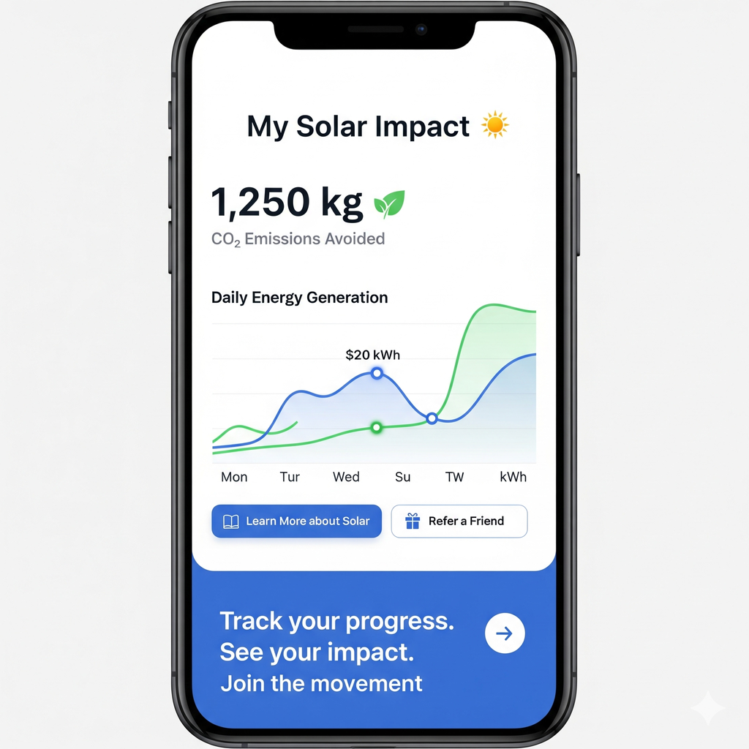
Prototype: "My Solar Impact" App Dashboard

Slide 21
External Communication Channels
Channels:
Public Relations & Media: To announce major projects, partnerships with NGOs, and policy recommendations.
Social Media (LinkedIn, Twitter): For investor relations, policy updates, and engaging with NGOs and the broader public.
Digital Platforms & Mobile App: To communicate directly with customers and empower them to track their contribution to SDG 13.
Rationale:
Rationale for Public Relations & Media: To announce major projects, partnerships, and policy recommendations.
Rationale for Social Media (LinkedIn, Twitter): For investor relations, policy updates, and engaging with NGOs and the broader public.
Rationale for Digital Platforms & Mobile App: To communicate directly with customers and empower them to track their contribution to SDG 13.

Slide 22
Common Communication Strategy: A Unified Approach
Strategy:
Develop a unified, single campaign to be used for both internal and external audiences, creating a cohesive brand identity and a shared sense of purpose.
Rationale for Strategy:
A common strategy reinforces the idea that the company's mission is central to its identity, not just a marketing effort. It shows that employees, customers, and investors are all part of the same mission to combat climate change and its impacts. This aligns with the core value of Collaboration.

Slide 23
Strategy & Rationale: Unifying our message
Strategy:
"Solar for Climate" Campaign: A unified campaign with a consistent message promoted across both internal and external channels. The campaign will use a cohesive visual identity and key messages focusing on the direct link between solar power and climate action.
Joint Recognition Event: Host an annual event that brings together employees, investors, and community partners to celebrate achievements in climate action.
Storytelling Initiative: Collect and share stories from employees and customers about how SolNova's work is positively impacting their lives and the environment.
Rationale for Strategy:
Rationale for "Solar for Climate" Campaign: A consistent brand message builds credibility and reinforces the company's commitment to SDG 13 for all stakeholders.
Rationale for Joint Recognition Event: This fosters a sense of community and shared purpose, aligning with our value of Collaboration.
Rationale for Storytelling Initiative: Humanizing the company's work through personal narratives connects with both audiences and makes climate action relatable.

Slide 24

Prototype: "Solar for Climate" Campaign Visual

Slide 25
Channels
Channels:
Social Media: A single social media presence on platforms like LinkedIn, Facebook, and Instagram to share the "Solar for Climate" campaign, employee success stories, and customer testimonials.
Annual Report & Website: The website and annual report will feature dedicated sections on the company's progress towards SDG 13, highlighting both internal and external contributions.
Shared Events: The annual "SolNova Impact Gala" which will be attended by both internal teams and external partners, serving as a unifying platform.
Rationale:
Rationale for Social Media: A single social media presence on platforms like LinkedIn, Facebook, and Instagram to share the "Solar for Climate" campaign, employee success stories, and customer testimonials.
Rationale for Annual Report & Website: The website and annual report will feature dedicated sections on the company's progress towards SDG 13, highlighting both internal and external contributions.
Rationale for Shared Events: The annual "SolNova Impact Gala" which will be attended by both internal teams and external partners, serving as a unifying platform.

Slide 26
Contribution
Team Members
AMAN SINGH – [ Design of Presentation ]
KSHITIJ BARANWAL – [ Information Collection ]
ANISH DEY –[Design of Company Logo]
PRATEEK SAGAR – [ Information Collection ]
ROHIT GHOSH – [ Design of Presentation ]
ADHIRAJ SINGH – [ Design of Presentation]

Slide 27
References
GDP and Economic Contribution:
The Guardian. (n.d.). Solar and wind generation together accounted for nearly 7% of global electricity generation in 2024.
Growth Rates & Market Size:
Fortune Business Insights. (n.d.). Solar power market size, share & COVID-19 impact analysis.
Grand View Research. (n.d.). Solar energy systems market size, share & trends analysis report.
IBISWorld. (n.d.). Solar energy production in the US.
Solar Power Europe. (n.d.). Global solar market outlook 2024-2028.

Slide 28
References
Key Players & Market Share:
Wikipedia. (n.d.). Jinko Solar.
Wikipedia. (n.d.). JA Solar.
Reuters. (n.d.). First Solar projects 2025 sales of $4.9–5.7 billion.
Wikipedia. (n.d.). Vikram Solar.
Trade.gov. (n.d.). India: Renewable energy.
UN SDG 13:
United Nations Development Programme (UNDP). (n.d.). Sustainable Development Goals. Retrieved from https://www.undp.org/sustainable-development-goals
Wikipedia. (n.d.). Sustainable Development Goal 13. Retrieved from https://en.wikipedia.org/wiki/Sustainable_Development_Goal_13
United Nations. (n.d.). Goal 13: Take urgent action to combat climate change and its impacts. Retrieved from https://sdgs.un.org/goals/goal13#targets_and_indicators

Slide 29
References
PESTLE Analysis:
DCF Modeling. (n.d.). Solar industry PESTEL analysis. Retrieved from https://dcfmodeling.com/products/solarindsns-pestel-analysis
Frontiers in Sustainability. (2022). A PESTEL analysis of India's renewable energy sector. Retrieved from https://www.frontiersin.org/journals/sustainability/articles/10.3389/frsus.2022.990173/full
India's Commitments:
Press Information Bureau (PIB), Government of India. (n.d.). India's updated NDC to be submitted to UNFCCC. Retrieved from https://www.pib.gov.in/PressReleaseIframePage.aspx?PRID=1961797

Slide 30
References
Sectoral Classification & Scope of Industry:
MyScheme. (n.d.). PM Surya Ghar Muft Bijli Yojana. Retrieved from https://www.myscheme.gov.in/schemes/pmsgmb
Ministry of New and Renewable Energy (MNRE). (n.d.). Solar off-grid programme. Retrieved from https://mnre.gov.in/en/solar-off-grid/
Ministry of New and Renewable Energy (MNRE). (n.d.). Solar Park Scheme. Retrieved from https://cdnbbsr.s3waas.gov.in/s3716e1b8c6cd17b771da77391355749f3/uploads/2024/10/20241014958242917.pdf

